Slide 1



CPU SCHEDULING SIMULATOR
PRESENTATION
Welcome! This presentation demonstrates how CPU scheduling and virtual memory management algorithms work through simulation, helping visualize core operating system concepts and performance behavior.
GROUP 9

Slide 2









MEMBERS
Platforms
Thái Tuấn (Leader)
Xuân Hùng
CONSOLE APPLICATION (C++)–WINDOWS?
Duy Khang
Gia Huy

Slide 3





PROJECT OBJECTIVES
CPU Scheduling Simulation
Virtual Memory Management Simulation
CSV-based Input & Output
Console-based Results
Performance & Stress Testing

Slide 4
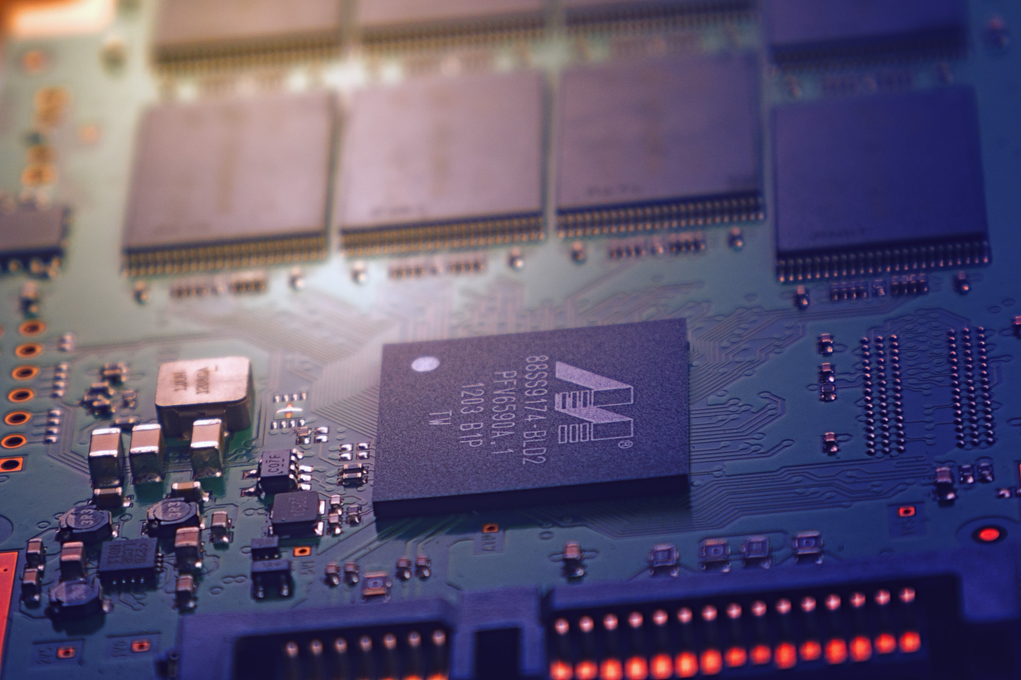

System Architecture
cpu/
- FCFS
- Priority
memory/
- FIFO
- LRU
gantt/
- Gantt Chart
utils/
- CSV Reader / Writer
test/
- Stress & Performance Test

Slide 5

CPU Scheduling Algorithms
Algorithms:
- FCFS (First Come First Serve)
- Non-preemptive Priority
Input:
- PID
- Arrival Time
- Burst Time
- Priority
Output:
- Start Time
- Completion Time
- Waiting Time
- Turnaround Time

Slide 6

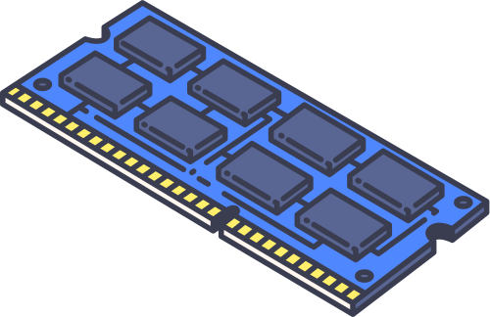
Memory Management Algorithms
Algorithms:
- FIFO Page Replacement
- LRU Page Replacement
Input:
- Page reference string (CSV)
- Frame size
Output:
- Page Fault count
- Frame status at each step
- Result exported to CSV file

Slide 7
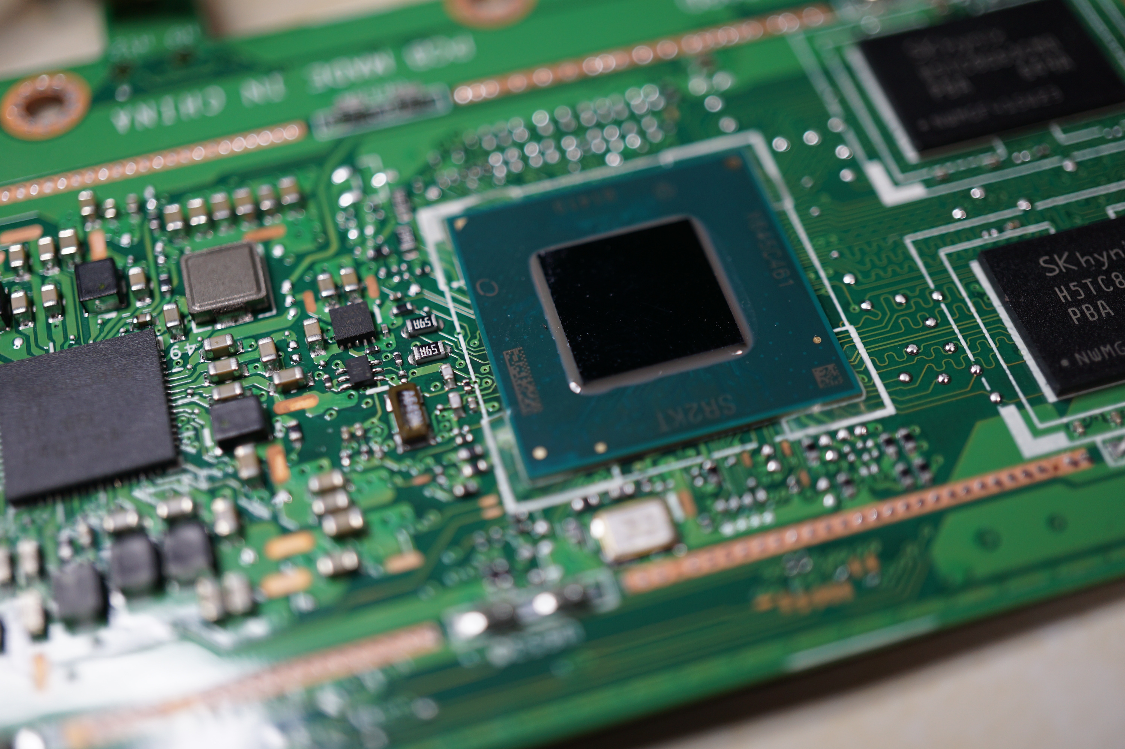
Stress Test & Performance Analysis
Automated Data Generation:
Randomized generation of large-scale datasets (Inputs)
Execution Time Measurement (ms):
CPU Scheduling: FCFS vs. Priority.
Memory Management: FIFO vs. LRU.
Output:
Results exported to performance_test.csv for analysis.
Objective:
Demonstrate system stability and algorithmic efficiency under high load

Slide 8
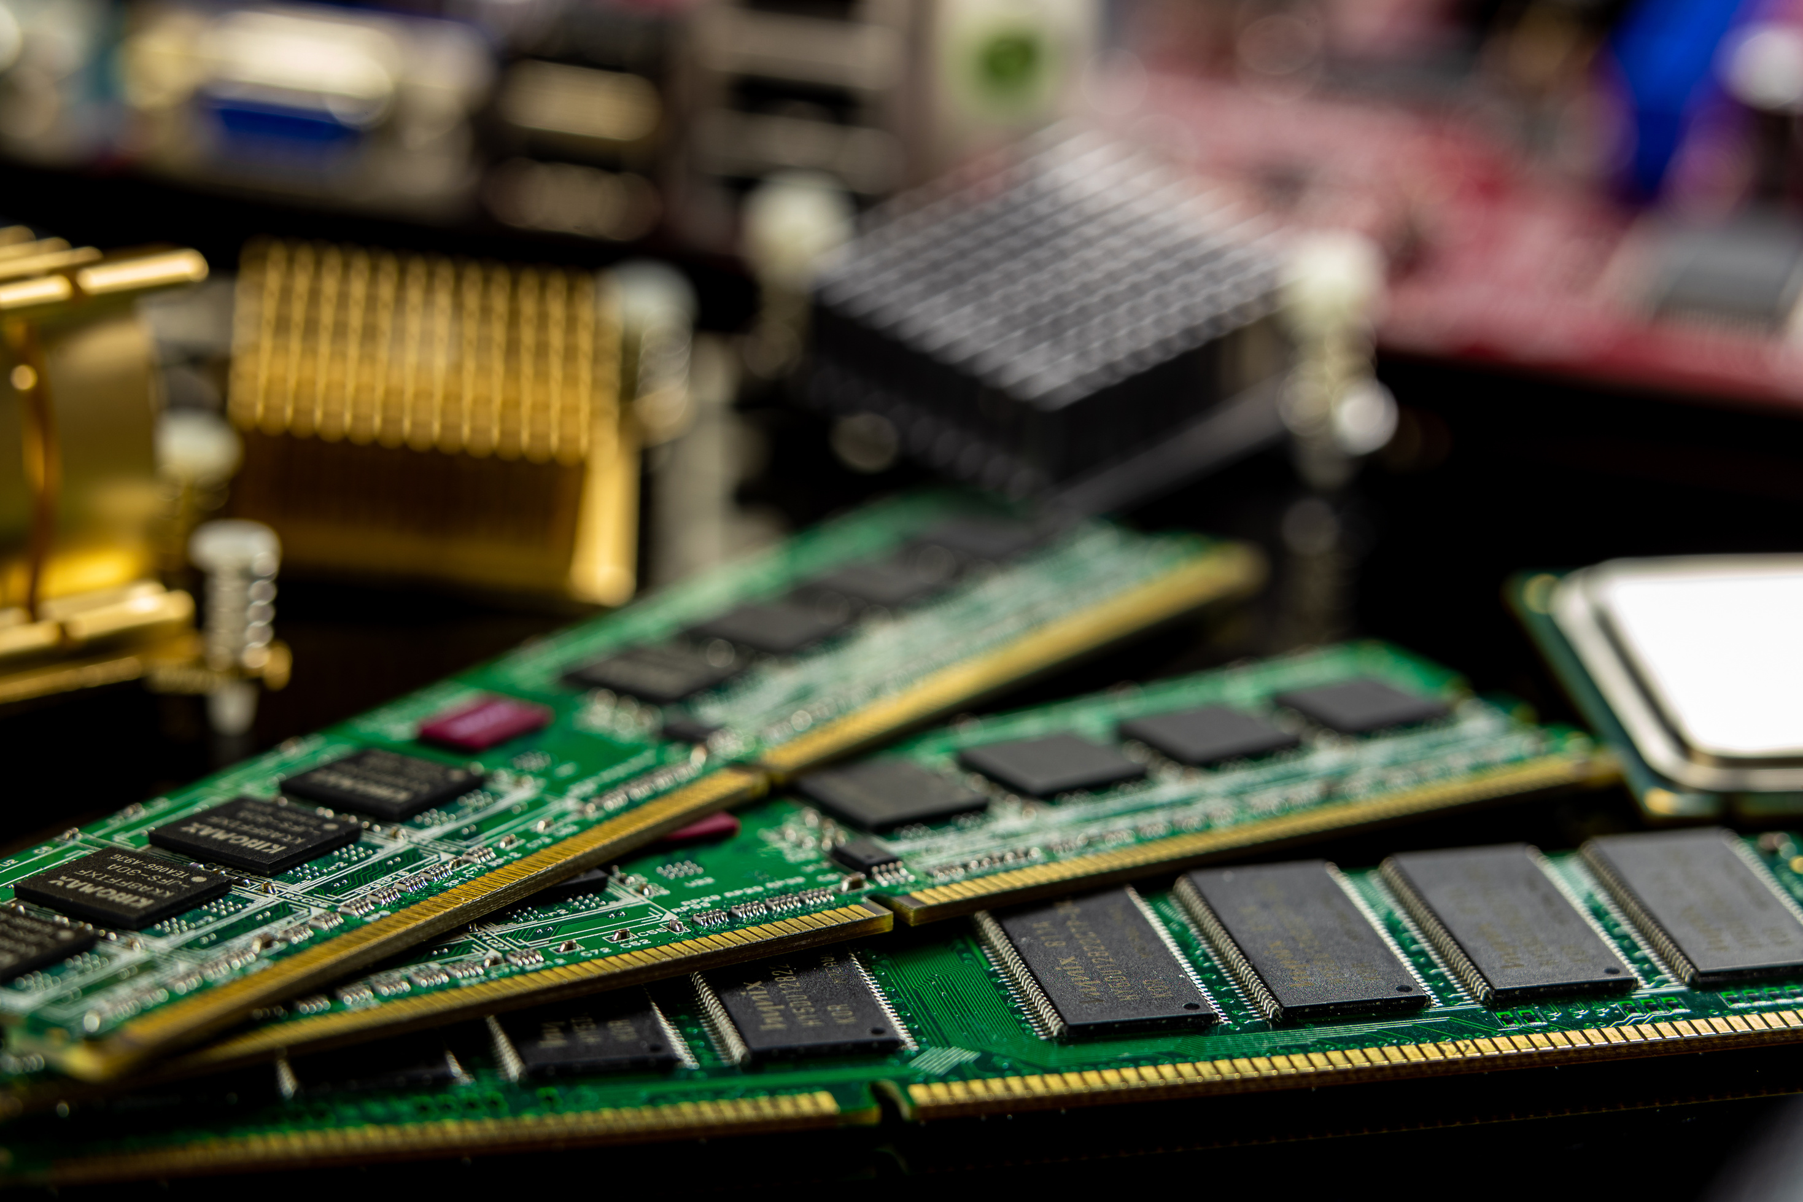
Results Verification & Evidence
Results & Validation
Real-time Feedback:
Live Console Output during execution.
Data Exports (CSV Analysis):
CPU: fcfs_result.csv, priority_result.csv
Memory:memory_fifo_result.csv,memory_lru_result.csv
Visuals: gantt_chart.csv
Version Control:
Git History verifying individual team member contributions.

Slide 9
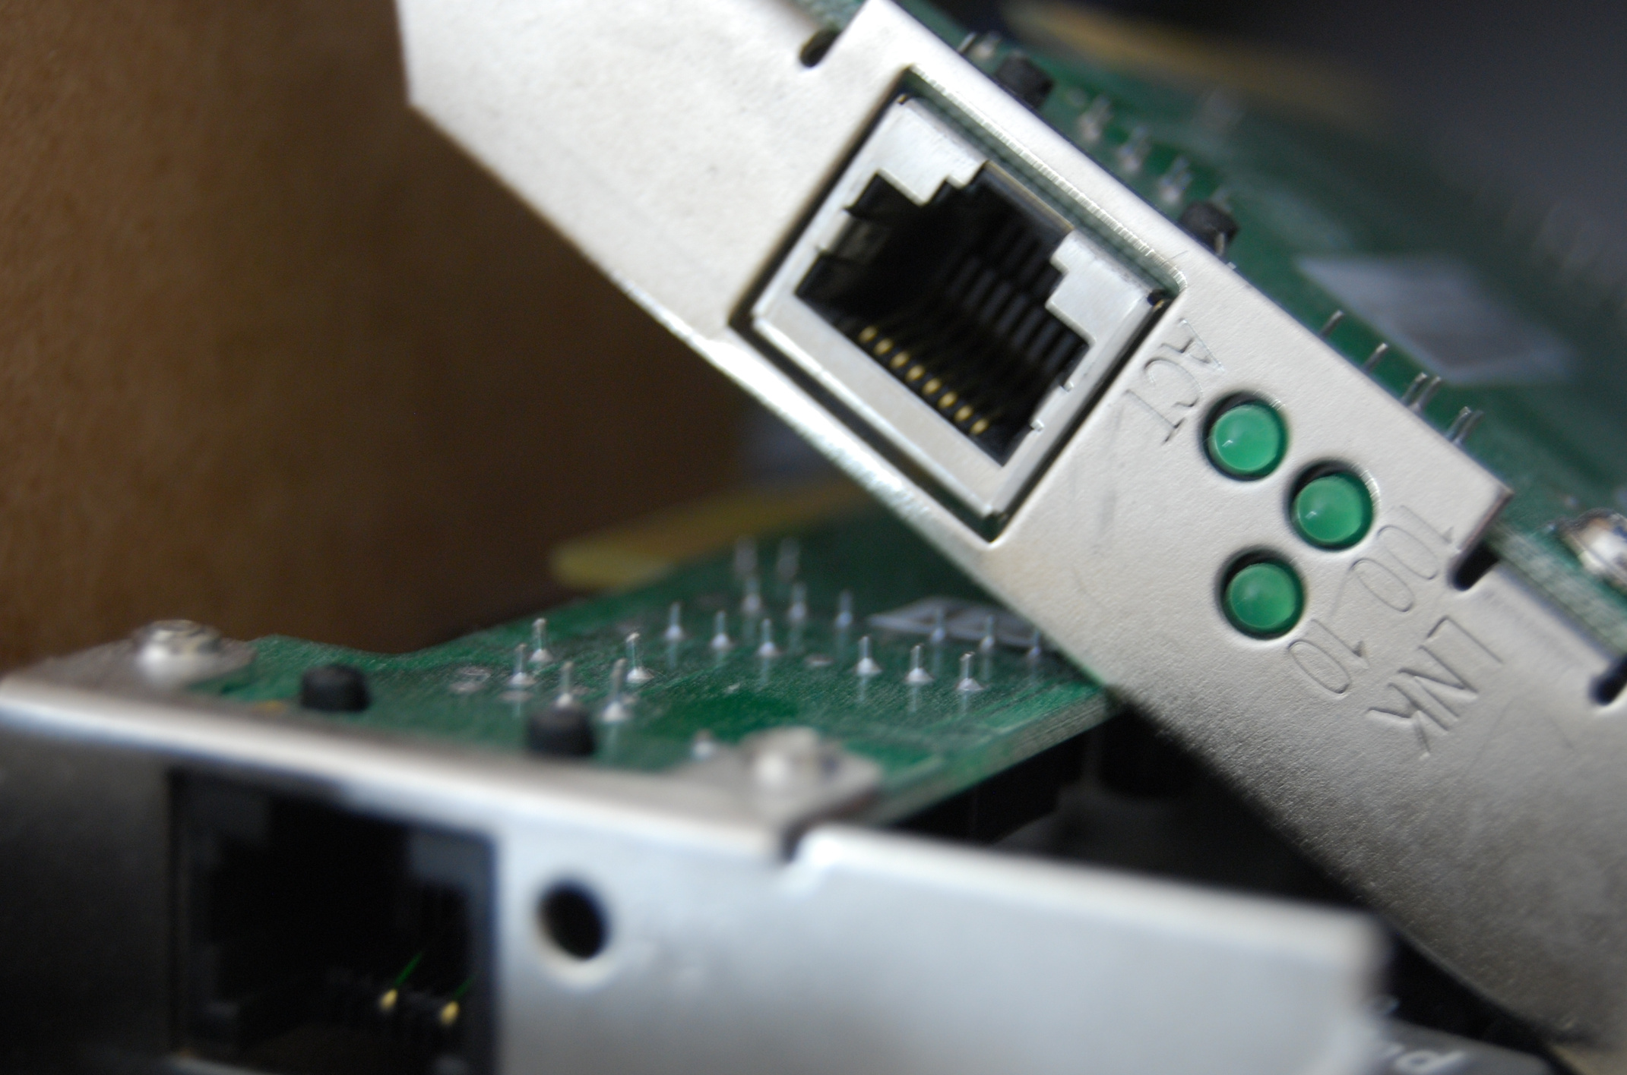
Conclusion
Project Success:
100% of requirements met.
High accuracy(Verifieagainst textbook logic).
Stable performance on Windows.
Key Takeaways:
Deep understanding of OS Algorithms.
Teamwork & Collaboration.
Git Workflow & CSV Data Processing.

